Slide 1
The Daemon - Design
A Background Service that runs without User input.
That activates rules that need to be set off at a certain point in time, once or repeated.
Currently only functions to add points.
Could be expanded to handle ”Activate Tag” and ”Block Tag”.
Implemented with Python as it has this functionality.

Slide 2
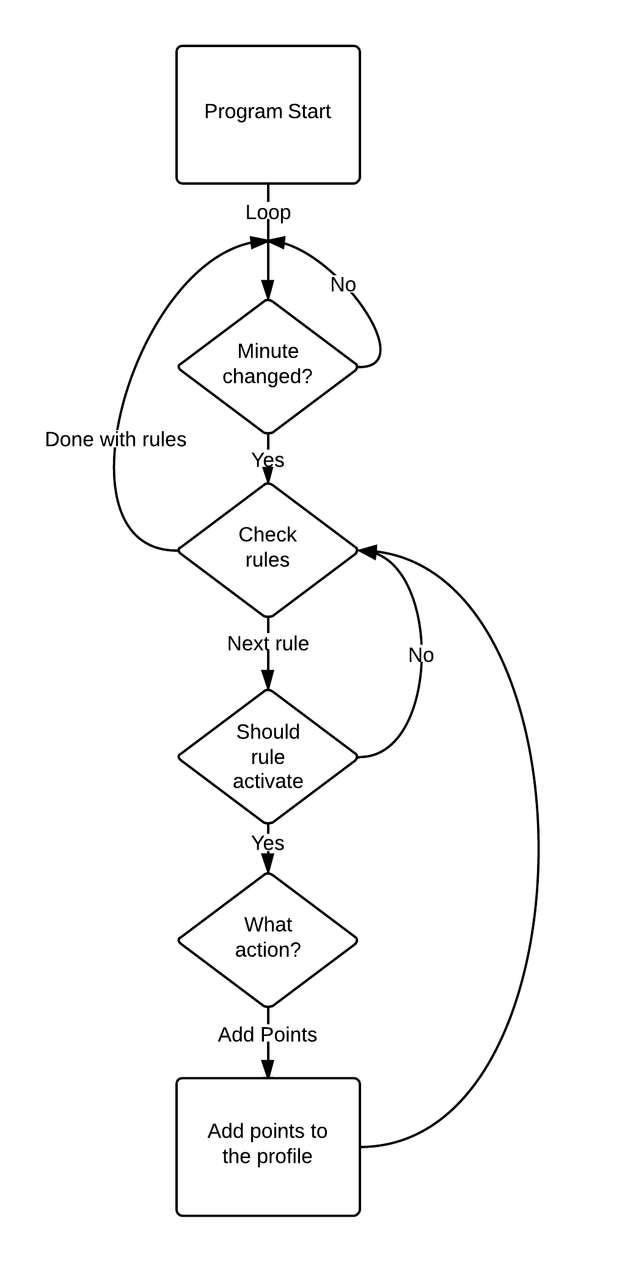
The Daemon
Example of functionality:
Communicates directly with the Database.
Checks the rules with:
Actions
Conditions.
Profiles.
Checks every minute.
The checks are based on from/to time and options to repeat.
Weekday: Checks with time from/to time on weekdays without repeatability.
Weekly: Activates based on the difference between the date it starts and the date it checks.
Last/First of: Activates if the current day is the first or last of a given weekday of the month.

Slide 3
The API – Design
A middleman between the Database and controller.
Is made to be simple with 3 commands.
Get Status: Allows for the controller to check how much time is left or if it needs to turn off.
TurnOn: Asks permission to turn on. Checks permissions and time remaining.
TurnOff: Tells the database that the user wants to turn off. Checks if its the user that logged in first.

Slide 4
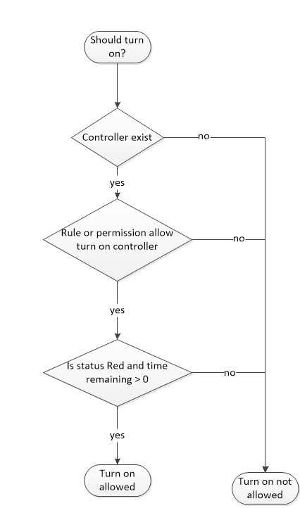
The API – Implementation
TurnOn - Call by:
http://example.com/api/api.php/turnOn/cID/tID
Returns:
{”status”:”OK”, ”timeRemaining”:”value”}
or
{”status”:”ERROR”,”error”:”Error Message”}

